Slide 1

Advanced Software Development with Java Series
Speaker: Rishi S.
Java Concurrency Unlocked
Tackling Concurrency Challenges with Expert Solutions

Slide 2

Objectives
After this module you will be able to:
Understand the core concepts, principles, and techniques related to threading and concurrent programming in Java.
Enhance problem-solving skills by working through actual concurrency issues from top-tier investment banks.
Learn the best practices for addressing race conditions, synchronization issues, and deadlocks in Java applications.
Implement the Producer-Consumer pattern and control thread execution in Java applications.

Slide 3

Threading Fundamentals
Race Condition
Synchronization Issue
Deadlock Issue
Stopping Threads
Producer-Consumer Pattern
Thread States
Recap

Slide 4

Threading Fundamentals
What is Concurrency?
In computer science, concurrency is the execution of the multiple instruction sequences at the same time.
In more technical terms, concurrency is the ability of different parts or units of a program, algorithm, or problem to be executed out-of-order or in partial order, without affecting the outcome.
This allows for parallel execution of the concurrent units, which can significantly improve overall speed of the execution in multiprocessor and multicore systems.
Java Concurrency Unlocked

Slide 5
Threading Fundamentals
What is Concurrency?
It may also refer to the decomposability of a program, algorithm, or problem into order-independent or partially-ordered components or units of computation.
Java Concurrency Unlocked

Slide 6
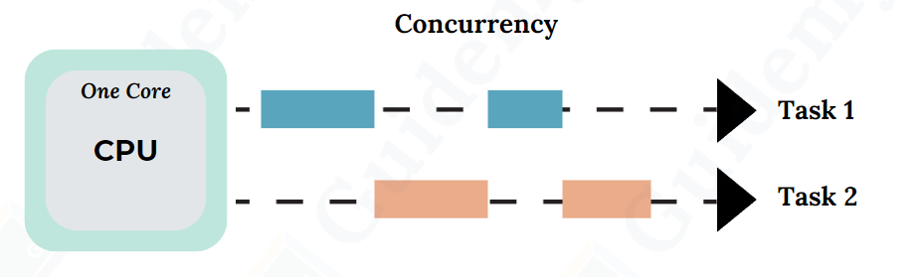
Threading Fundamentals
Case 1: CPU with only one core
CPU will be executing processes one by one, individually by time slice.
A time slice is short time frame that gets assigned to process for CPU execution.
Java Concurrency Unlocked

Slide 7
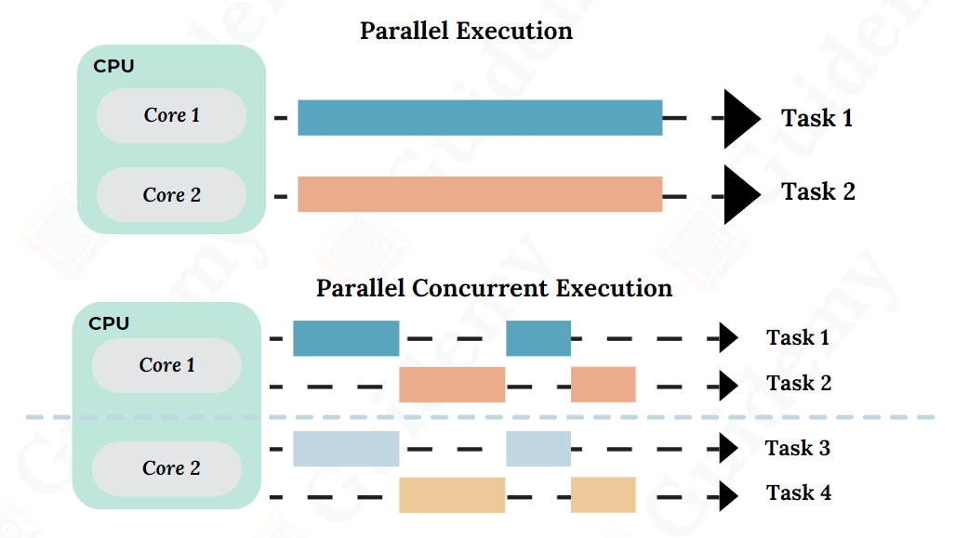
Threading Fundamentals
Case 2: CPU with multiple cores
Only on multicore CPU system, multiple processes execute at the same time on different cores.
Java Concurrency Unlocked

Slide 8
Threading Fundamentals
What is CPU Scheduling?
CPU Scheduling is a process that allows one process to use the CPU while another process is delayed (in standby) due to unavailability of any resources such as I/O etc., thus making full use of the CPU.
Whenever the CPU becomes idle, the operating system must select one of the processes in the line ready for launch.
The selection process is done by a temporary (CPU) scheduler.
The Scheduler selects between memory processes ready to launch and assigns the CPU to one of them.
Java Concurrency Unlocked

Slide 9
Threading Fundamentals
When will the Scheduler pause a thread?
Scheduler may pause a thread due to:
The thread is waiting for some more data
The thread is waiting for another thread to do something
CPU should be shared equally among threads
Java Concurrency Unlocked

Slide 10
Threading Fundamentals
What is a Java Thread?
We can define threads as a light-weight subprocess within the smallest unit of processes and having separate paths of execution.
These threads use shared memory, but they act independently.
Hence, if there is an exception in a thread, that will not affect the working of other threads despite them sharing the same memory.
Java Concurrency Unlocked

Slide 11
Threading Fundamentals
Few points about Java Thread
Thread is a set of instructions defined at Operating System level
Lightweight sub-process through which we can perform multiple activities within a single process
An application can be composed of multiple threads
=> JVM itself works with several threads like GC, JIT, etc.
Different threads can be executed at the same time on different cores or CPUs
Java Concurrency Unlocked

Slide 12
Threading Fundamentals
Race Condition
Synchronization Issue
Deadlock Issue
Stopping Threads
Producer-Consumer Pattern
Thread States
Recap

Slide 13
Threading Fundamentals
Race Condition
A race condition, in the simplest terms, is when two or more actions compete to complete first, causing unpredictable results.
Example:
Imagine two people trying to withdraw money from a joint bank account with a balance of $100. Both of them want to withdraw $80, but there's not enough money in the account for both withdrawals.
In programming, this can happen when two or more threads access and modify a shared resource simultaneously without proper synchronization, leading to unpredictable and unintended results.
Java Concurrency Unlocked

Slide 14
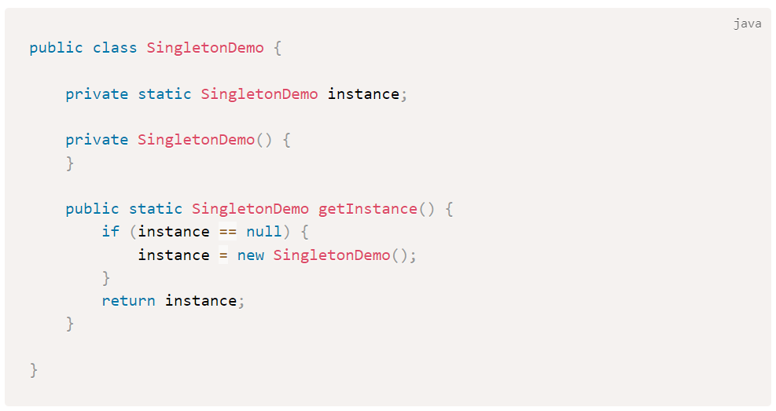
Threading Fundamentals
Interview Questions #1: Merrill Lynch - Demonstrate race condition in Singleton pattern and how to fix it
Java Concurrency Unlocked

Slide 15
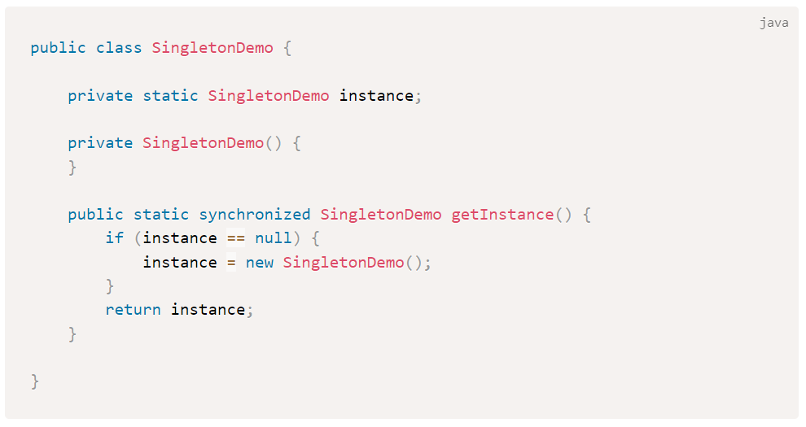
Threading Fundamentals
Interview Questions #1: Merrill Lynch - Demonstrate race condition in Singleton pattern and how to fix it
Java Concurrency Unlocked

Slide 16
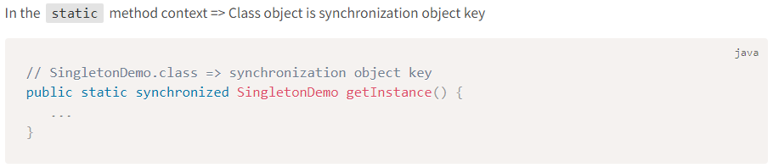
Threading Fundamentals
More on Synchronization
For synchronization to work, we need a synchronization object key also called as monitor or mutex.
Every Java object can play as monitor or mutex.
Java Concurrency Unlocked

Slide 17
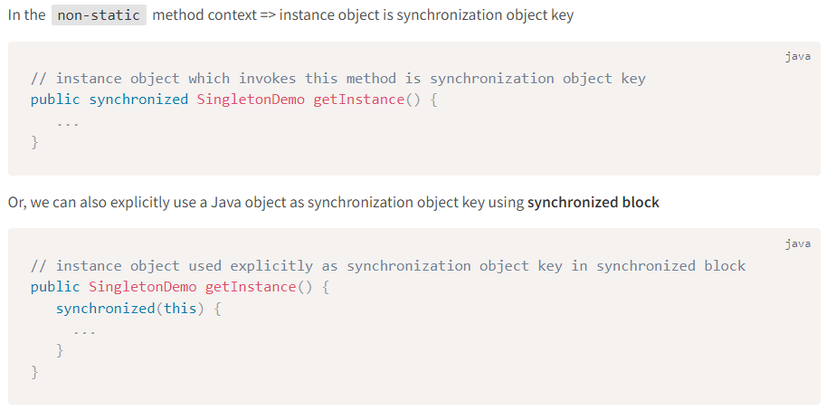
Threading Fundamentals
More on Synchronization
Java Concurrency Unlocked

Slide 18
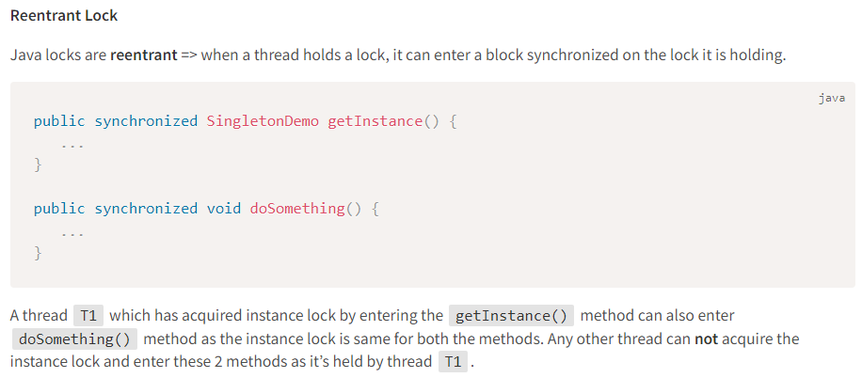
Threading Fundamentals
More on Synchronization
Java Concurrency Unlocked

Slide 19
Threading Fundamentals
Deadlock
A deadlock is a situation where a thread T1 holds a key needed by a thread T2, and T2 holds the key needed by T1.
In this situation, both the threads will keep on waiting for each other indefinitely.
There is nothing we can do if the deadlock situation happens but to restart the JVM.
However, even identifying a deadlock is very complex in the modern JVMs or monitoring tools.
Java Concurrency Unlocked

Slide 20
Threading Fundamentals
How to create and run threads in Java?
The most basic way is to:
Create a Runnable instance
Pass it to the Thread constructor
Invoke start() method on Thread object
Java Concurrency Unlocked

Slide 21
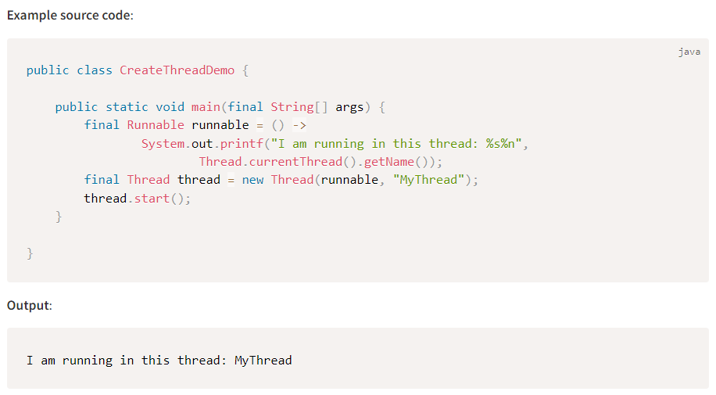
Threading Fundamentals
How to create and run threads in Java?
Java Concurrency Unlocked

Slide 22
Threading Fundamentals
Race Condition
Synchronization Issue
Deadlock Issue
Stopping Threads
Producer-Consumer Pattern
Thread States
Recap

Slide 23
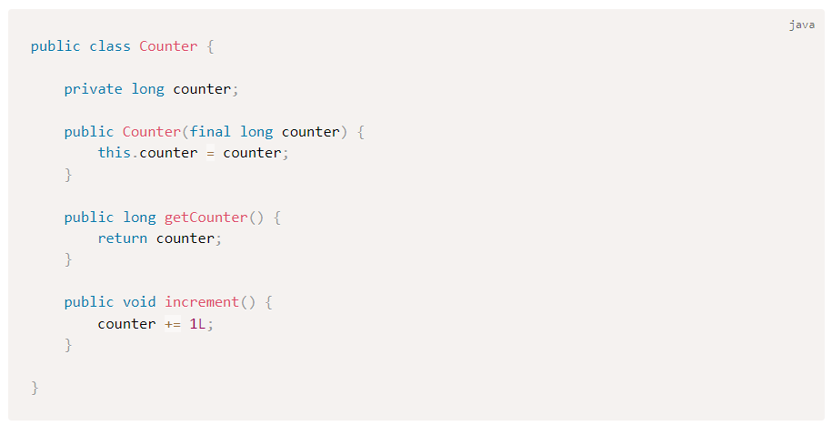
Synchronization Issue
Interview Questions #2: JP Morgan Chase - Demonstrate synchronization issue and fix the code
Java Concurrency Unlocked

Slide 24
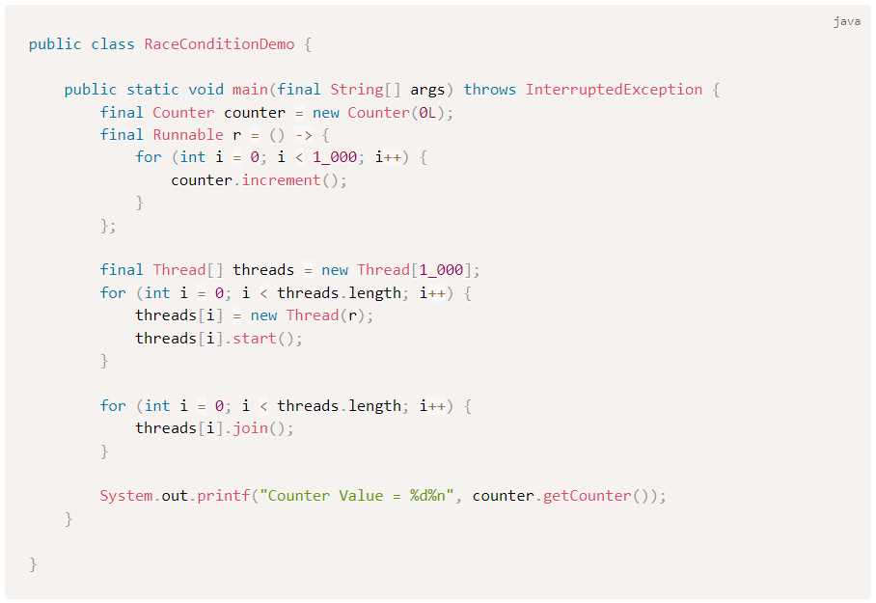
Synchronization Issue
Interview Questions #2: JP Morgan Chase - Demonstrate synchronization issue and fix the code
What is the output of the counter value?
Is the output going to be consistent for every run? If not, what is the issue?
If any race condition, fix the code.
Java Concurrency Unlocked

Slide 25
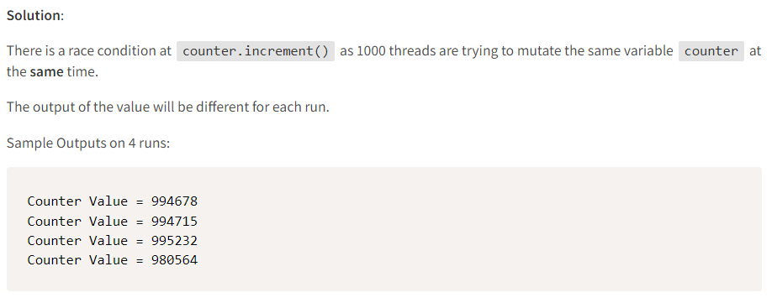
Synchronization Issue
Interview Questions #2: JP Morgan Chase - Demonstrate synchronization issue and fix the code (Solution)
Java Concurrency Unlocked

Slide 26
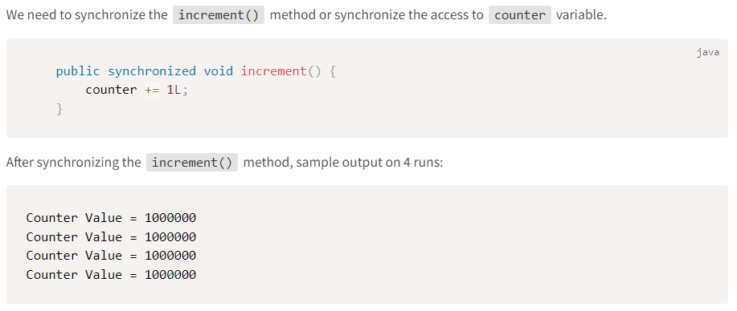
Synchronization Issue
Interview Questions #2: JP Morgan Chase - Demonstrate synchronization issue and fix the code (Solution)
Java Concurrency Unlocked

Slide 27
Threading Fundamentals
Race Condition
Synchronization Issue
Deadlock Issue
Stopping Threads
Producer-Consumer Pattern
Thread States
Recap

Slide 28
Deadlock Issue
Interview Problem #3: Goldman Sachs - Demonstrate deadlock issue and fix the code
Write a program to demonstrate deadlock issue where a thread T1 holds a key needed by a thread T2, and T2 holds the key needed by T1. Fix the code.
Java Concurrency Unlocked

Slide 29
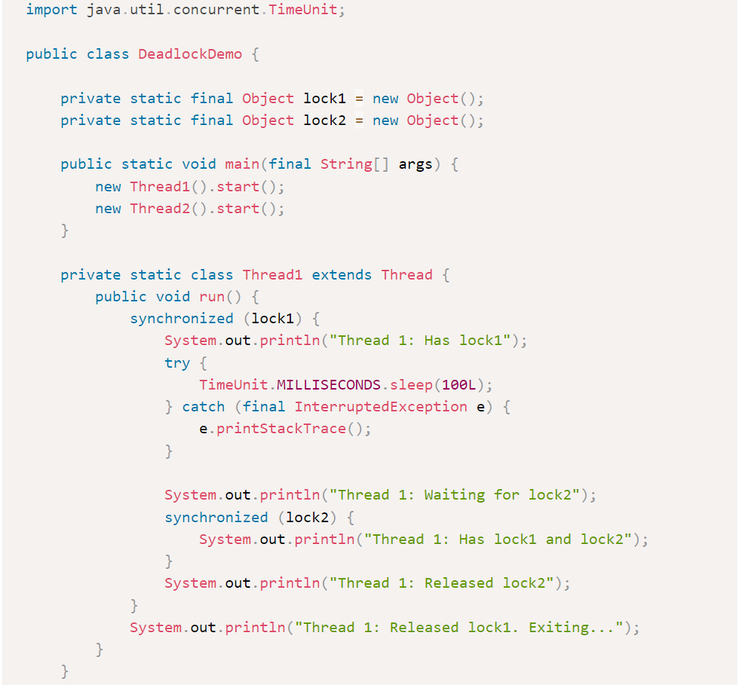
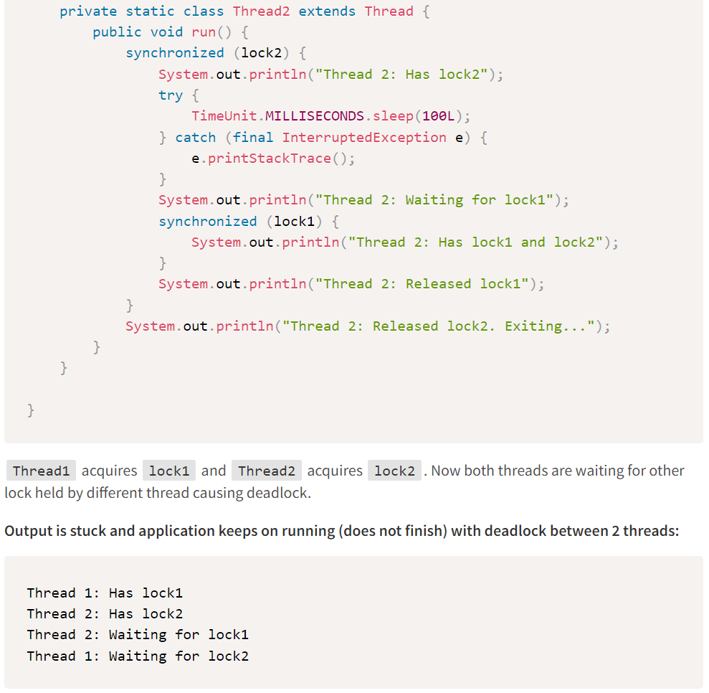
Deadlock Issue
Java Concurrency Unlocked

Slide 30
Deadlock Issue
Interview Problem #3: Goldman Sachs - Demonstrate deadlock issue and fix the code (Solution)
Deadlock issue can be fixed by maintaining the same sequence for locks acquisition.
Both Thread1 and Thread2 can acquire lock1 and lock2 in the same sequence thus avoiding the deadlock issue.
Java Concurrency Unlocked

Slide 31
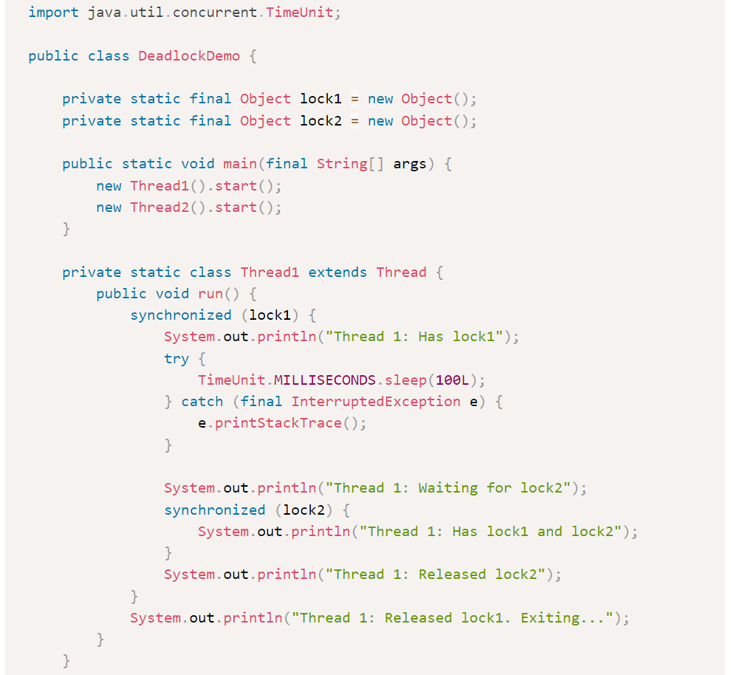
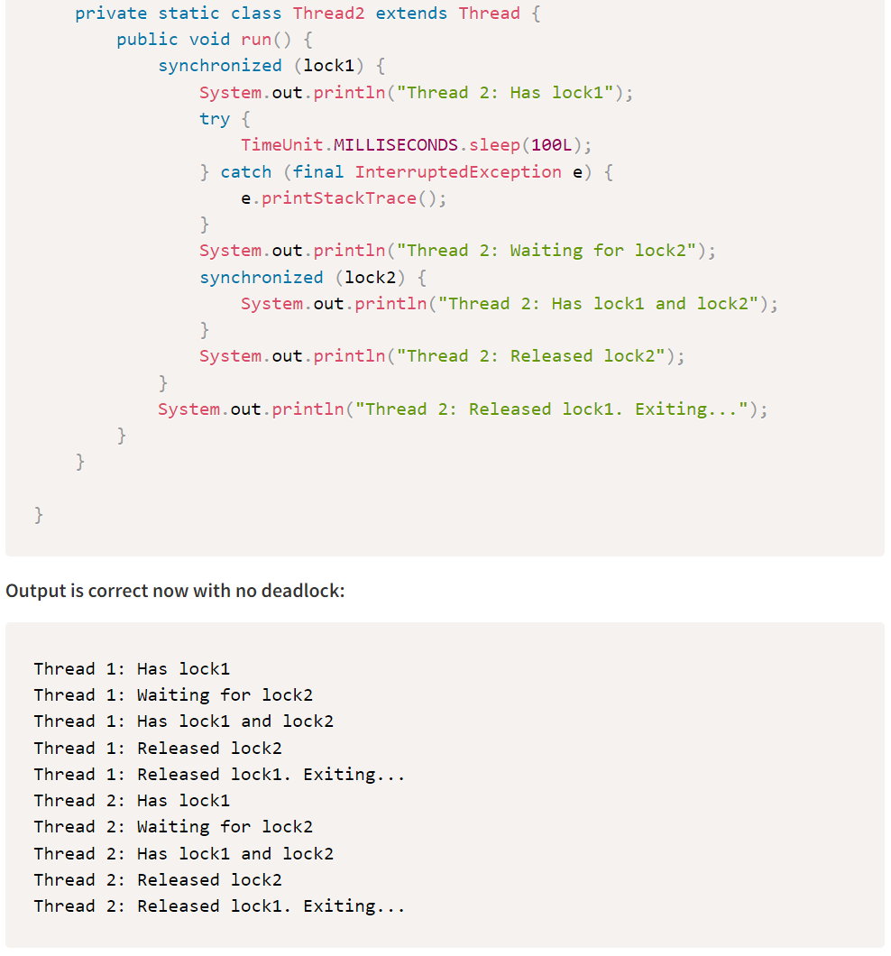
Deadlock Issue
Java Concurrency Unlocked

Slide 32
Threading Fundamentals
Race Condition
Synchronization Issue
Deadlock Issue
Stopping Threads
Producer-Consumer Pattern
Thread States
Recap

Slide 33
Thread Coordination
Interview Problem #4: Barclays - How to stop a thread in Java?
We should NOT use Thread.stop() method as it is deprecated.
Thread.stop() can lead to monitored objects being corrupted, and it is inherently unsafe.
Solutions:
Use a thread-safe boolean variable to control thread execution
Call interrupt() on a running thread
Java Concurrency Unlocked

Slide 34
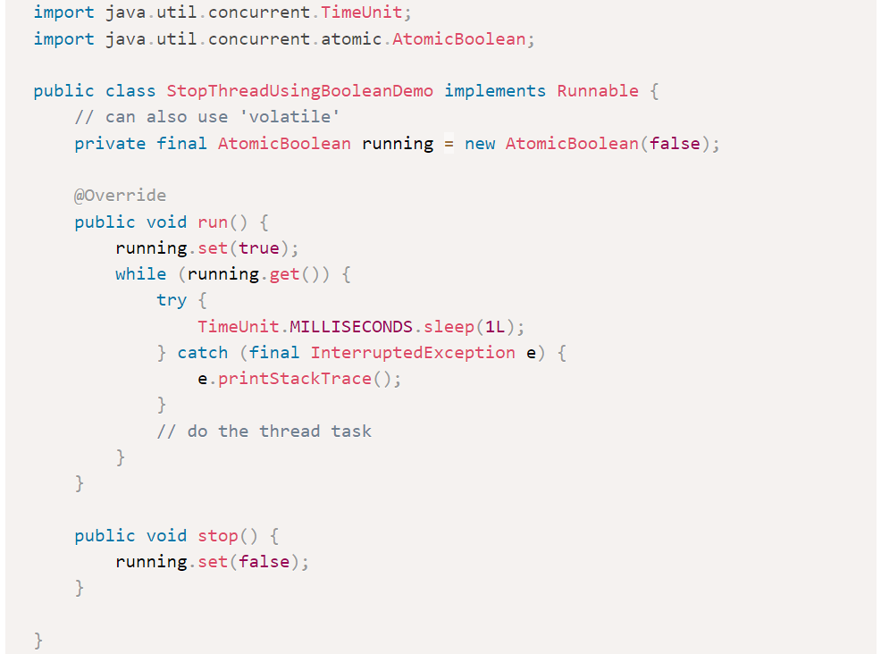
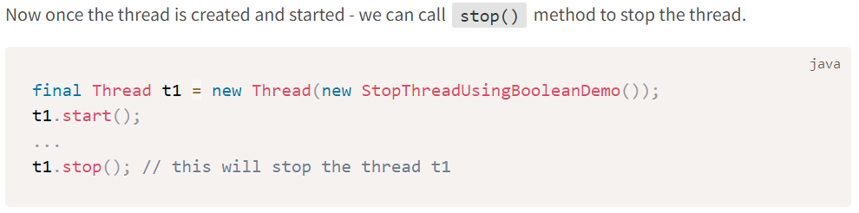
Thread Coordination
Solution #1: Use a thread-safe boolean variable to control thread execution
Java Concurrency Unlocked

Slide 35
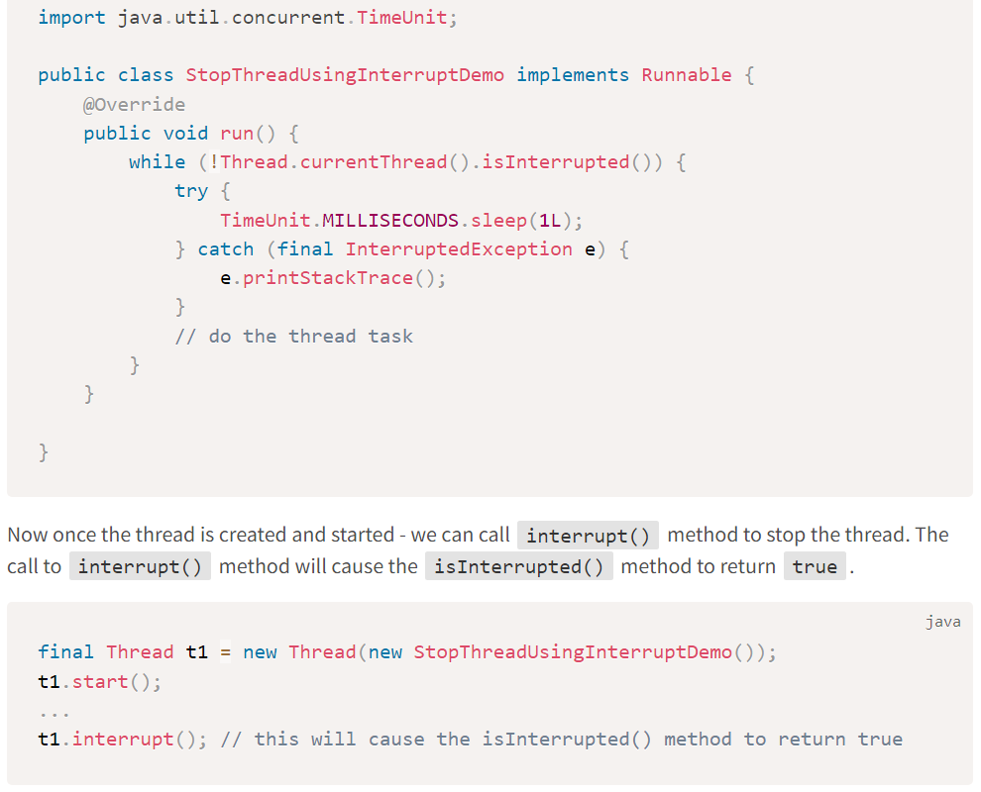
Thread Coordination
Solution #2: Call interrupt() on a running thread
All the blocking methods like wait(), notify(), notifyAll(), join(), sleep() etc. throw InterruptedException based on the same interrupted status of thread.
The interrupt mechanism is implemented using an internal flag known as the interrupt status.
Invoking non-static Thread.interrupt() sets this flag
When a thread checks for an interrupt by invoking the static method Thread.interrupted(), interrupt status is cleared
The non-static Thread.isInterrupted() method, which is used by one thread to query the interrupt status of another, does NOT change the interrupt status flag
By convention, any method that exits by throwing an InterruptedException clears interrupt status when it does so. However, it’s always possible that interrupt status will immediately be set again, by another thread invoking interrupt.
Java Concurrency Unlocked

Slide 36
Threading Fundamentals
Race Condition
Synchronization Issue
Deadlock Issue
Stopping Threads
Producer-Consumer Pattern
Thread States
Recap

Slide 37
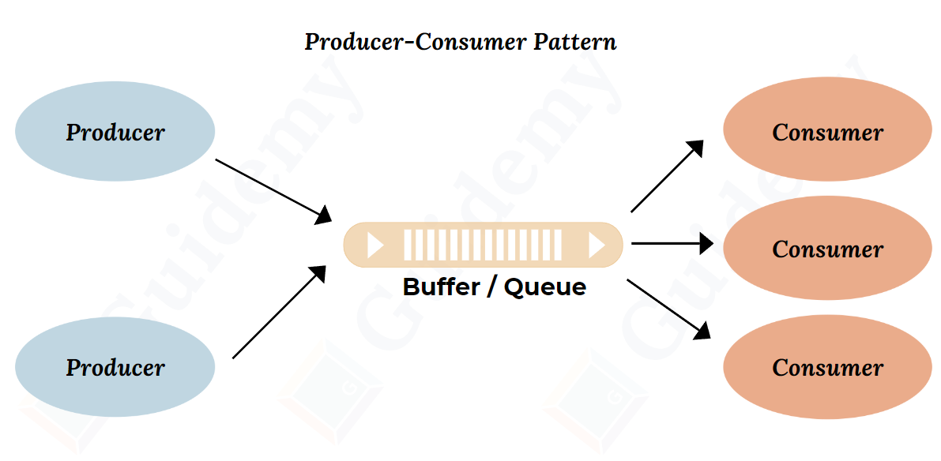
Producer-Consumer Pattern
Interview Problem #5: Macquarie - Explain and Implement Producer Consumer pattern
We have a buffer - it can be an array, list, set or queue.
A producer produces values in a buffer.
A consumer consumes the values from this buffer.
Producers and Consumers are run in their own threads or thread pools.
Buffer can be bounded (having a defined capacity) or unbounded (based on system memory available).
Edge cases - The buffer can be full or empty:
If full (bounded buffer):
producers cannot write to it
If empty:
consumers cannot read from it.
Java Concurrency Unlocked

Slide 38
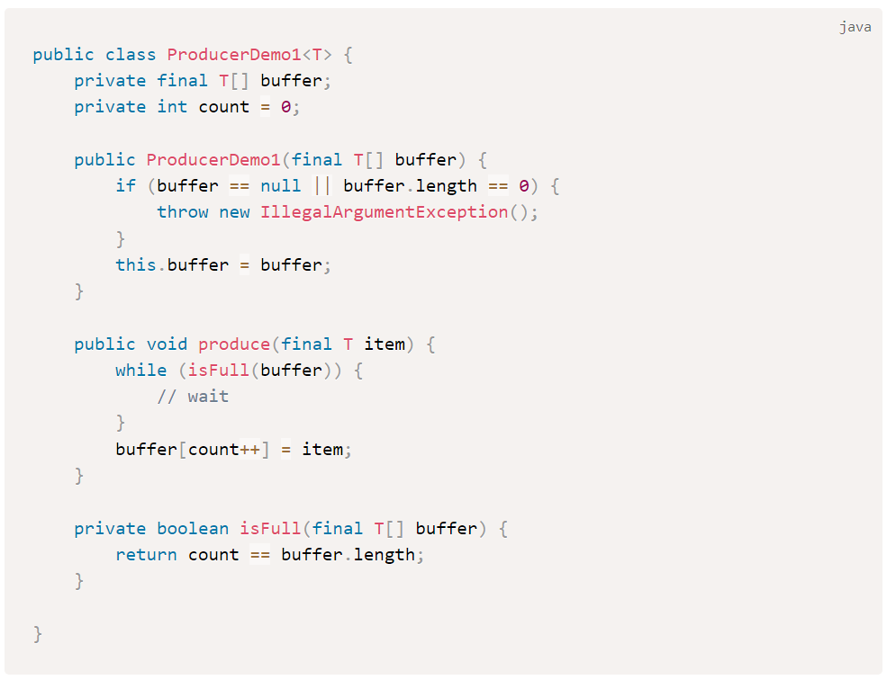
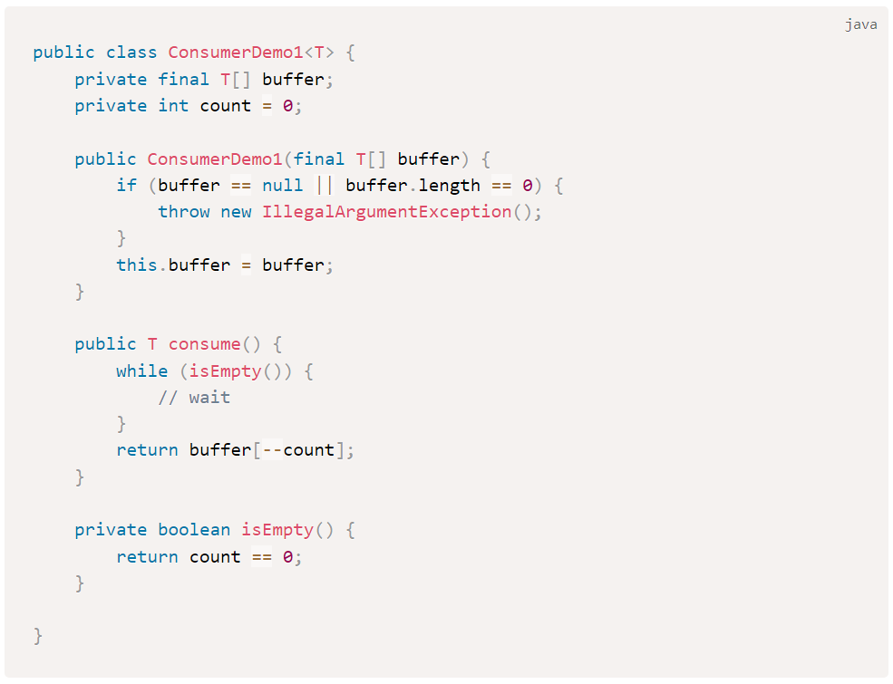
Producer-Consumer Pattern
Implementation #1
Java Concurrency Unlocked

Slide 39
Producer-Consumer Pattern
Implementation #1
Major flaw in this code:
As several threads are producing (writing) and consuming (popping) the buffer at the same time => this will result in race condition.
In other words, buffer and count variables are NOT thread-safe.
Java Concurrency Unlocked

Slide 40
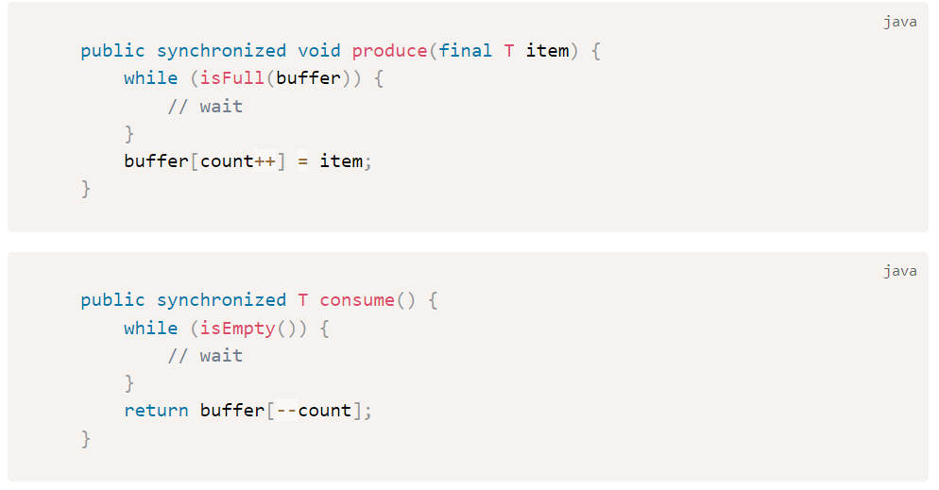
Producer-Consumer Pattern
Implementation #2: Use synchronization
Using synchronization will help to fix the race condition problem
However, it will only synchronize all producer threads to call produce() and synchronize all consumer threads to call consume().
Producer and Consumer threads are still independent of each other and not synchronized across for both produce() and consume() methods.
We want the common buffer to be thread safe for both produce() and consume() methods.
Java Concurrency Unlocked

Slide 41
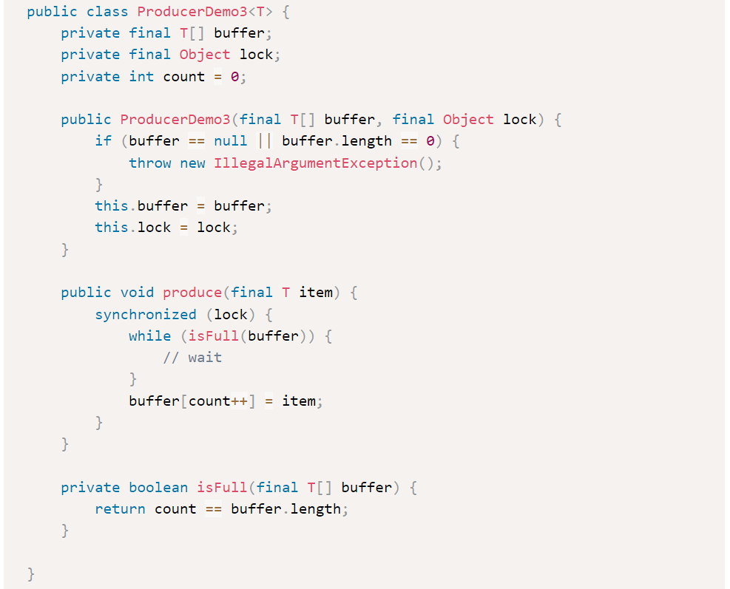
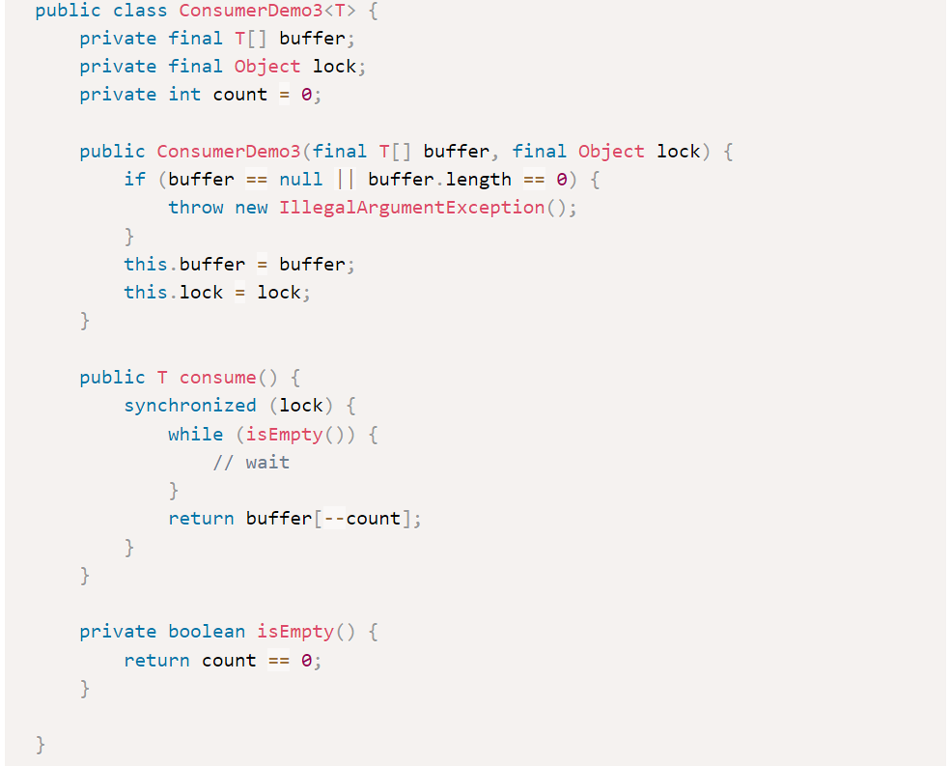
Producer-Consumer Pattern
Implementation #3: Use global lock to be used by both Producer and Consumer:
Java Concurrency Unlocked

Slide 42
Producer-Consumer Pattern
Implementation #3: Use global lock to be used by both Producer and Consumer:
Now both the buffer and Object lock are common to be used by both Producer and Consumer.
However, still this design has a major flaw!
Suppose if the buffer is empty:
Consumer threads will hold the lock object and keep on doing busy spinning inside: while (isEmpty(buffer)).
Producer threads will keep on waiting for this lock object held by the consumer thread indefinitely and never be able to produce or write anything to buffer.
Java Concurrency Unlocked

Slide 43
Producer-Consumer Pattern
Interview Problem #5: Macquarie - Explain and Implement Producer Consumer pattern (Solution)
We need a mechanism to somehow “park” this consumer thread when the buffer is empty and release the lock.
Then the producer thread can acquire this lock and write to the buffer.
When the “parked” consumer thread is woken up again - the buffer will not be empty this time, and it can consume the item.
This is the wait() / notify() pattern.
Java Concurrency Unlocked

Slide 44
Producer-Consumer Pattern
Interview Problem #5: Macquarie - Explain and Implement Producer Consumer pattern (Solution)
The wait(), notify() and notifyAll() methods are defined in java.lang.Object class. These methods are invoked on a given object => normally the object lock being used.
The thread executing the invocation should hold that object key.
Thus, in other words, these methods cannot be invoked outside a synchronized block.
Calling wait() releases the key (object lock) held by this thread and puts the thread in WAIT state. The only way to release a thread from a WAIT state is to notify it.
Calling notify() release a thread in WAIT state and puts it in RUNNABLE state. This is the only way to release a waiting thread. The released thread is chosen randomly.
For notifyAll(), all the threads are moved from WAIT state to RUNNABLE state, however only one thread can acquire the lock again.
However, the woken threads can do other task rather than waiting for the object again.
Java Concurrency Unlocked

Slide 45
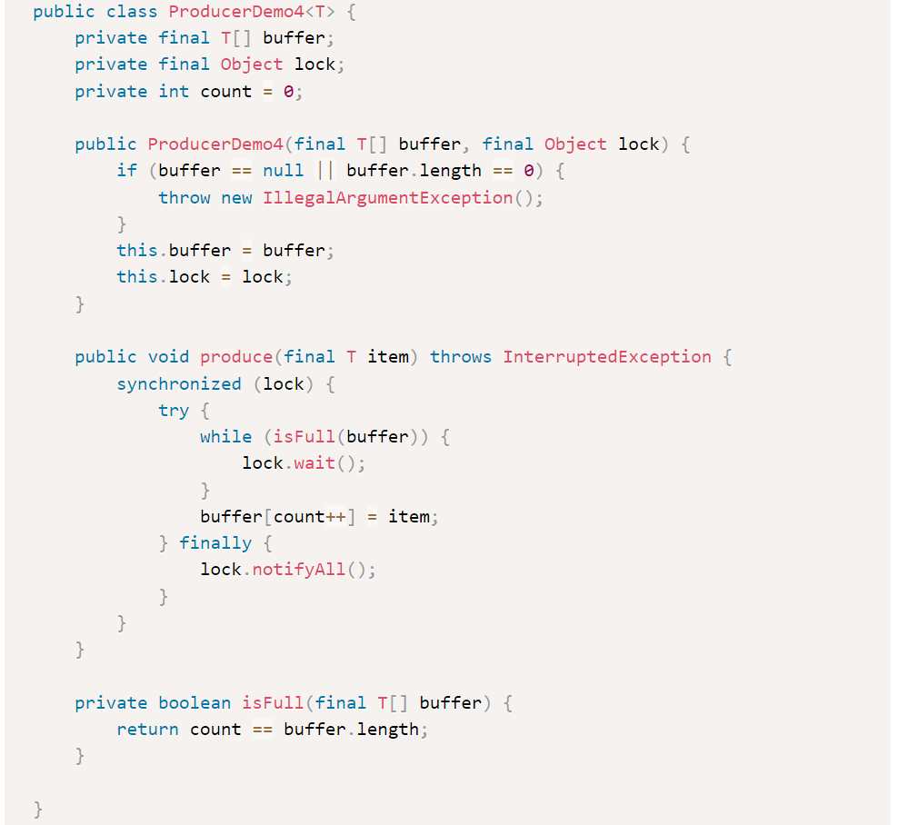
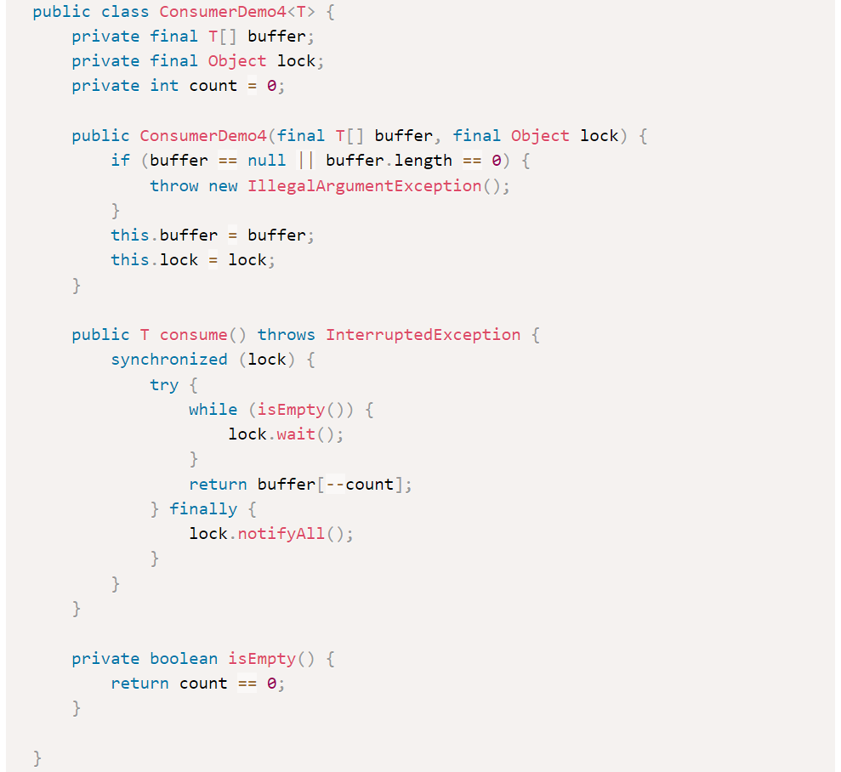
Producer-Consumer Pattern
Java Concurrency Unlocked

Slide 46
Threading Fundamentals
Race Condition
Synchronization Issue
Deadlock Issue
Stopping Threads
Producer-Consumer Pattern
Thread States
Recap

Slide 47
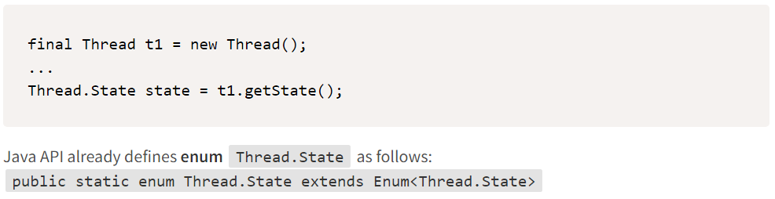
Thread States
Thread States
A thread has a state - for example, it can be running or not.
We can get the thread state by calling getState() method on thread.
Java Concurrency Unlocked

Slide 48
Thread States
Thread States
A thread can be in one of the following states:
NEW: A thread that has not yet started is in this state.
RUNNABLE: A thread executing in the Java virtual machine is in this state.
BLOCKED: A thread that is blocked waiting for a monitor lock is in this state.
WAITING: A thread that is waiting indefinitely for another thread to perform a particular action is in this state.
TIMED_WAITING: A thread that is waiting for another thread to perform an action for up to a specified waiting time is in this state.
TERMINATED: A thread that has exited is in this state.
Java Concurrency Unlocked

Slide 49
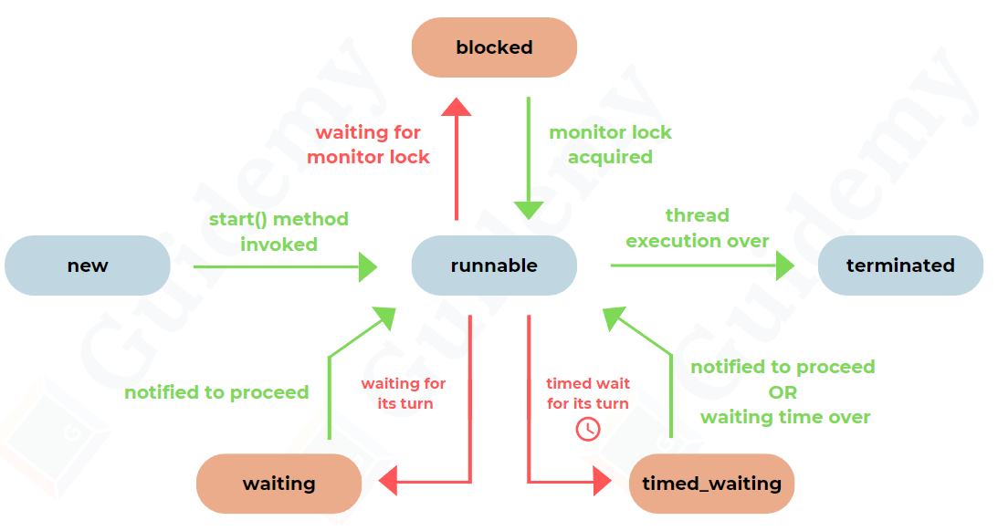
Thread States
Thread States
Java Concurrency Unlocked

Slide 50
Thread States
Thread States
A thread can be in only one state at a given point in time.
These states are virtual machine states which do not reflect any operating system thread states.
NOTE: If a thread is not running, can it be given hand by the thread scheduler ?
Answer is NO => thread scheduler will only schedule threads which are in RUNNABLE state.
Java Concurrency Unlocked

Slide 51
Threading Fundamentals
Race Condition
Synchronization Issue
Deadlock Issue
Stopping Threads
Producer-Consumer Pattern
Thread States
Recap

Slide 52

Summary
In computer science, concurrency is the execution of the multiple instruction sequences at the same time.
CPU Scheduling is a process that allows one process to use the CPU while another process is delayed (in standby) due to unavailability of any resources such as I/O etc., thus making full use of the CPU.
A Java thread is a light-weight subprocess within the smallest unit of processes and having separate paths of execution.
A race condition, in the simplest terms, is when two or more actions compete to complete first, causing unpredictable results.
Race condition can be resolved using synchronization.

Slide 53
Summary
Deadlock is where a thread T1 holds a key needed by a thread T2, and T2 holds the key needed by T1. Both threads are waiting for other lock held by different thread causing deadlock.
Deadlock issue can be fixed by maintaining the same sequence for locks acquisition.
A thread can be stopped using a thread-safe boolean variable or calling interrupt().
A Producer-Consumer Pattern is when:
We have a buffer - it can be an array, list, set or queue.
A producer produces values in a buffer.
A consumer consumes the values from this buffer.
Producers and Consumers are run in their own threads or thread pools.
A Producer-Consumer Pattern can be implemented using a wait-notify pattern.

Slide 54
Next Step
What’s Next?
This is just about the introduction to concurrency we have covered in this free trial session.
In the real module course - we will cover additional advanced topics on concurrency:
Thread pools
Concurrent Collections
Java Memory Model
Advanced Locking
Lock-Free Algorithms, Data Structures and Techniques
Fork-Join Framework
Java Concurrency Unlocked

